Slide 1
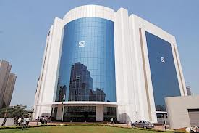
Introduction to Mutual Funds

Slide 2

DISCLAIMER
The information contained in this material is for only educational and awareness purposes related to securities market and shall be used for non-profitable educational and awareness activities for general public.
No part of this material can be reproduced or copied in any form or by any means or reproduced on any disc, tape, perforate media or other information storage device, etc. without acknowledging the SEBI or Stock Exchanges or Depositories.
SEBI or Stock Exchanges or Depositories shall not be responsible for any damage or loss to any one of any manner, from use of this material.
Every effort has been made to avoid errors or omissions in this material. For recent market developments and initiatives, readers are requested to refer to recent laws, guidelines, directives framed thereunder and other relevant documents, as being declared from time to time. For any suggestions or feedback, you may send the same to visitsebi@sebi.gov.in.
2

Slide 3
Flow of Presentation
What is a Mutual Fund ?
Structure of Mutual Fund
What is an Asset Management Company (AMC)?
How does a Mutual Fund Work?
Classification of Mutual Funds
Based on Structure
Based on Investment Objective
Investment Portfolio
Risk vs Return
Categorization of Mutual Funds
How to invest in Mutual Funds?
Centralized KYC
Mutual Fund investment procedure
Investment Modes in Mutual Funds
Mutual Funds
Plans – Growth vs Dividend Options
How to check information about the Mutual Funds (Offer Document)?
Risk-o-Meter
3

Slide 4
What is a Mutual Fund (MF)?
Common pool of funds contributed by investors and invested in accordance to the objectives.
Investments are held in a trust of which the investors alone are the joint beneficial owners.
Trustees oversee the management by investment manager.
4

Slide 5
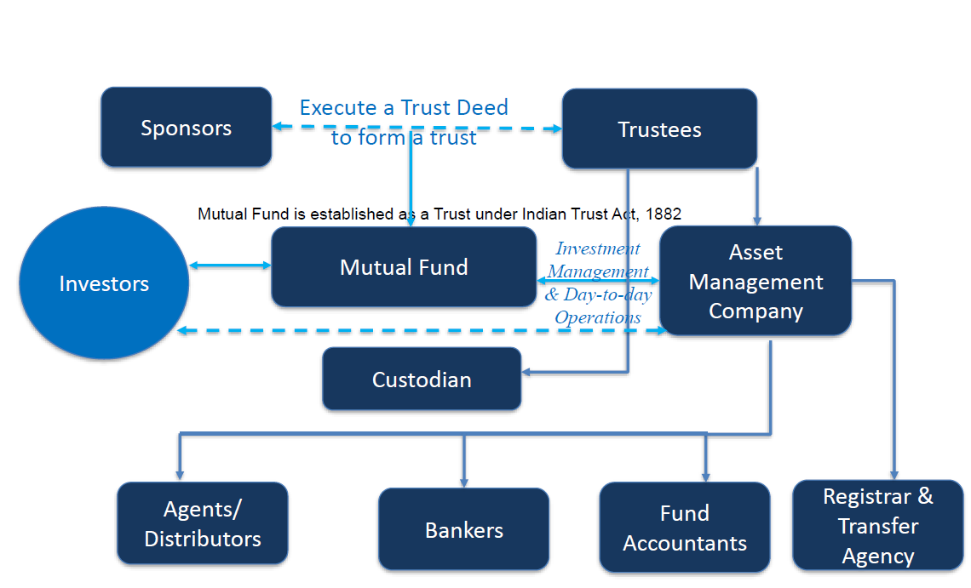
Structure of Mutual Fund
5

Slide 6
What is an Asset Management Company (AMC)?
Investment manager of the mutual fund.
Appointed by the trustees, with SEBI approval.
Trustees and AMC enter into an investment management agreement.
At least 50% of members of the board of an AMC have to be independent.
Required to invest seed capital of 1% of amount raised subject to a maximum of Rs.50 lakh in all open-ended schemes.
Should have a net worth of at least Rs.50 crore at all times.
AMC of one mutual fund cannot be an AMC or trustee of another fund.
AMCs cannot engage in any business other than that of financial advisory and investment management
6

Slide 7
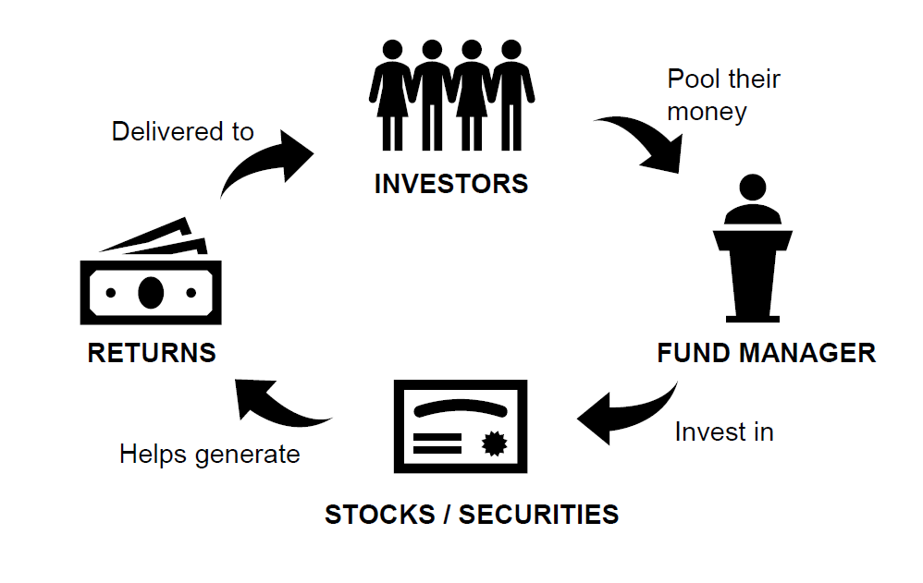
How does a Mutual Fund Work?
Pool of investors money.
Invested according to pre-specified investment objectives.
Benefits accrue to those that contribute to this pool.
There is thus mutuality in the contribution and the benefit.
Hence the name ‘mutual’ fund.
7

Slide 8
Classification of Mutual Funds
Classification of Mutual Funds
Based on Structure
Based on Investment Objective
Based on Investment Style
Open Ended Funds
Debt Funds
Passive Funds
Closed Ended Funds
Equity Funds
Active Funds
Interval Funds
Hybrid Funds
8

Slide 9
Classification - Based on Structure
Open Ended Funds
No fixed maturity date.
Closed Ended Funds
Run for a specific period.
Interval Funds
Variant of closed-ended funds.
Accept continuous sale and re-purchase requests.
Transactions are NAV-based.
Unit capital is not fixed.
Offered in an NFO but are closed for further purchases after NFO.
Unit capital is kept constant.
Becomes open-ended at specific intervals.
Have to be mandatorily listed.
9

Slide 10
Classification - Based on Investment Objective
Debt Funds
Equity Funds
Hybrid Funds
Invest in short and long term debt instruments.
Aim to provide regular income.
Invest in equity securities.
Aim to provide growth and capital appreciation over long term.
Invest in a combination of equity and debt securities.
Proportion of equity and debt may vary.
Aim to provide for both income and capital appreciation.
10

Slide 11
Classification - Based on Investment Style
Passive Funds
Active Funds
Replicate a market index.
Invest in same securities and in same proportion as that of index.
No active selection of any stock / sector.
Expenses are lower.
Portfolio is modified every time index composition changes.
Invests in securities and sectors that may offer a better return than the index.
Actively manage the allocation to market securities and cash.
May perform better or worse than the market index.
Incur a higher cost than passive funds.
11

Slide 12





Categorization of Mutual Fund Schemes
Categorization of open-end mutual funds:
To ensure uniformity in characteristics of similar type of schemes launched by different mutual funds.
Helps investors to evaluate different options available before making informed decision to invest.
Hybrid Schemes
Debt Schemes
Solution oriented Schemes
Categorization of Mutual Fund Schemes
Equity Schemes
Other Schemes
12

Slide 13
How to invest in Mutual Funds?
Via Physical Mutual Fund Application Form
Via Online Mode (Website of Mutual Fund)
Via Mobile App of Mutual Fund
Via AMFI Registered Mutual Fund Distributor (using physical form/ online/ mobile app)
13

Slide 14
Centralized KYC (C-KYC) in Securities Market
KYC registration is centralized through KYC Registration Agencies (KRAs) registered with SEBI.
Each investor to undergo KYC process only once in securities market and details would be shared with other intermediaries by the KRAs.
Standard Account Opening form (AOF) has 2 parts:
Part I : Basic and uniform KYC details of the investor
Part II : Additional KYC information as may be sought separately by the Mutual Fund
14

Slide 15
Mutual Funds investment procedure
Indicate whether you are a First Time Investor/ Existing Investor.
Visit official website of KRA and check whether you are KYC compliant or not. You must submit this KYC status.
Provide your details like name, address, etc.
Submit Bank account details and copy of “Cancelled Cheque”.
Once documents are accepted by Mutual Fund Company, you may start making investment.
15

Slide 16
Investment Modes in Mutual Funds
Lump-sum Investment
Systematic Investment Plan (SIP)
One time investment.
Staggered Investment.
Usually, large sum of money is invested in one go.
Investor faces risk of volatility in markets.
Period of commitment - 6 months, 1 / 3 / 5 years.
Specific intervals - monthly, quarterly, half-yearly.
Made on specific dates e.g. 1st, 5th, 10th, 15th of every month.
16

Slide 17
Investment Modes in Mutual Funds
Direct Mutual Fund
Directly offered by fund house.
Regular Mutual Fund
Bought through an intermediary.
No involvement of third party agents – brokers or distributors.
No commissions and brokerage.
Have low Expense ratio (because of no commissions).
Intermediaries can be brokers, advisors or distributors.
High Expense ratio as there are commissions to pay.
Low NAV.
Return is lower due to a higher expense ratio
Commissions and brokerage paid.
Have high NAV.
Return is higher due to a lower expense ratio
17

Slide 18
Mutual Fund Plans – Growth vs Dividend Options
Growth Option
Dividend
Payout Option
Gains made in portfolio are retained and reflected in NAV.
Fund declares dividend from realized profits.
Realized profit/loss is treated as capital gains or loss.
No increase or decrease in number of units, except if units are purchased or sold, by the investor.
NAV falls after dividend payout to the extent of dividend paid.
Dividend Reinvestment Option
Dividend is re-invested in same scheme by buying additional units at ex-dividend NAV.
Number of units standing to the credit of the investor, increases each time a dividend is declared, and reinvested back into the scheme.
Amount and frequency varies and depends upon distributable surplus.
18

Slide 19
How to check information about
the Mutual Funds (Offer Document)?
Statement of additional information (SAI)
Contains generic and statutory information of mutual fund.
Scheme information document (SID)
Contains financial information of mutual fund.
Lays down rights of investor.
Investment objective.
Asset allocation.
Investment strategies.
Terms with regard to liquidity.
Fees and expenses.
Scheme type (open or closed end).
Other information relating to the scheme.
Other additional information.
19

Slide 20
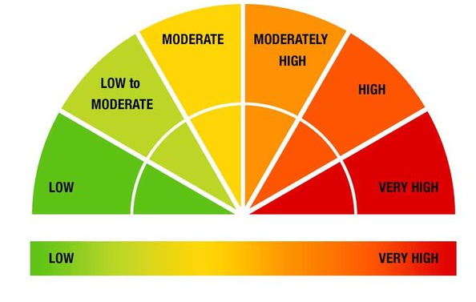
Risk-o-Meter and its importance
Six levels of risk for mutual fund schemes:
i. Low Risk
ii. Low to Moderate Risk
iii. Moderate Risk
iv. Moderately High Risk
v. High Risk and
vi. Very High Risk
Importance of Risk-o-meter :
Helps align risk that a fund carries with the risk profile of the investor.
Equity as asset class: Volatile: High risk
Debt as asset class: Stable: Low risk
Hybrid: Moderate: Depends on allocation and concentration
20

Slide 21
Thank You
21

